Slide 1




CLOUD9 IDE &
ZEND STUDIO
BIJAY KOIRALA

Slide 2
TABLE OF CONTENT
IDE
Cloud9 IDE
Zend Studio
Conclusion

Slide 3

INTRODUCTION TO IDE
IDE stands for Integrated Development Environment.
a software application that provides comprehensive facilities for software development.
a fancy digital toolbox where developers write, edit, and manage their code

Slide 4
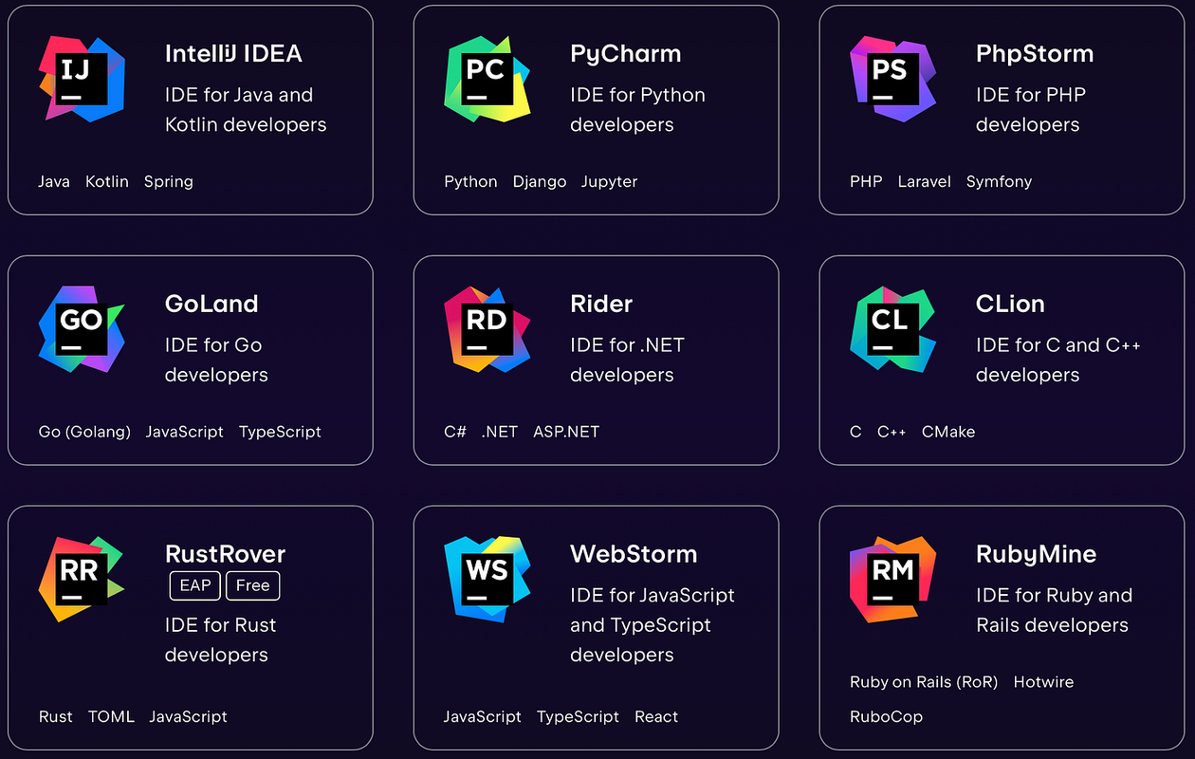
Modern IDE Examples
Is VS code IDE or code editor ?

Slide 5
IDE Advantges
Efficiency: Combines coding, debugging, and project management tools in one place for a smoother workflow.
Productivity: Features like auto-completion and error highlighting help developers write better code faster.
Consistency: Provides a unified environment, reducing the need to switch between different tools.
Integration: Easily connects with other software development tools, streamlining the development process.
Debugging: Built-in debugging tools help find and fix errors in the code efficiently.

Slide 6

Introduction to Cloud9 IDE
Cloud9 is an integrated development environment (IDE) that lives in the cloud, meaning we can write, run, and debug code directly from the web browser. No messy installations or configurations needed !
Pre-loaded with tools for popular languages(40) like Python, JavaScript, PHP, and more.

Slide 7
Getting started to use Cloud9 IDE
Create an AWS account (free tier available).
Set up AWS Cloud9
Create an AWS Cloud9 environment (Open the Cloud9 console and choose an environment template.)
Start coding! Explore the editor, terminal, and pre-installed tools.

Slide 8
Who use Cloud9 IDE ?
Large organizations: LinkedIn, Accenture, Salesforce, Soundcloud, Heroku, Mailchimp, Mozilla, Merck, American Chemical Society, BNP Paribas.

Slide 9
Benefits of Cloud9 IDE
Accessibility: Code from anywhere, any device, just with a browser.
Flexibility: No complex setups, just start coding directly.
Collaboration: Share your environment and work together in real-time.
Integration: Easily deploy the code to AWS services like Lambda, API Gateway, S3, and DynamoDB..
Build Serverless Applications with Ease

Slide 10
Cons of Cloud9 IDE
Depends upon internet and server capability.
Costly for premium features.
It can be slower sometimes.
Limited customization

Slide 11
Can we use cloud9 without AWS ?
Yes, we can use Cloud9 without AWS, but it's important to note that Cloud9 was initially developed as an independent platform and later acquired by Amazon Web Services (AWS). While AWS integration provides additional features and services, Cloud9 can still be used without an AWS account.

Slide 12
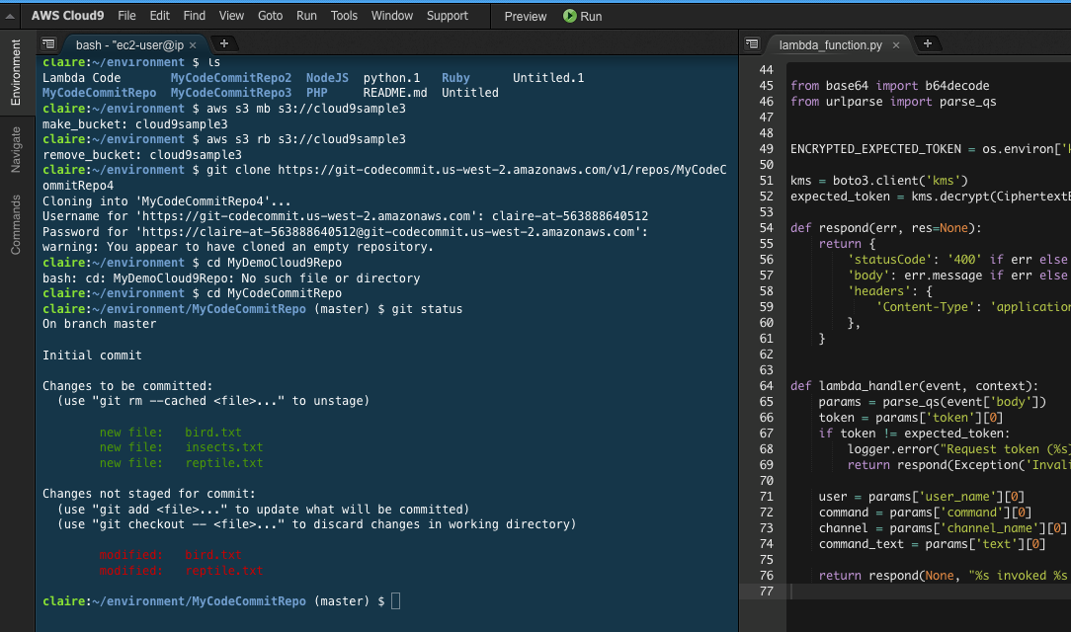
Cloud9 Interface

Slide 13

Introduction to Zend Studio(13)
Integrated development environment (IDE) that is specifically designed for PHP development.

Slide 14
Benefits of Zend Studio v13
Fully supports the latest PHP versions
Offers advanced features like code completion, refactoring, and debugging
Seamless integration with current versions of popular frameworks like cakePHP, laravel etc

Slide 15
Cons of Zend Studio
Cost: Zend Studio is a paid software.
Because of complex features, it maye hard to use in begning.
Limited Language Support: Only PHP.
Outdated Version Concerns: The latest officially supported version (Zend Studio 13.6) was released in 2018.

Slide 16
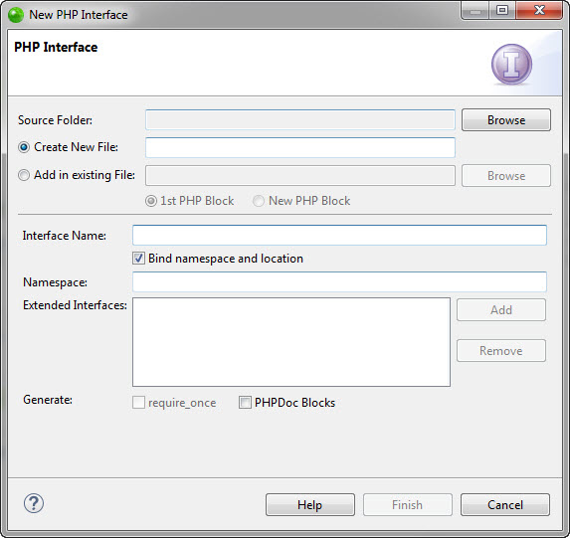
Zend Studio Interface

Slide 17
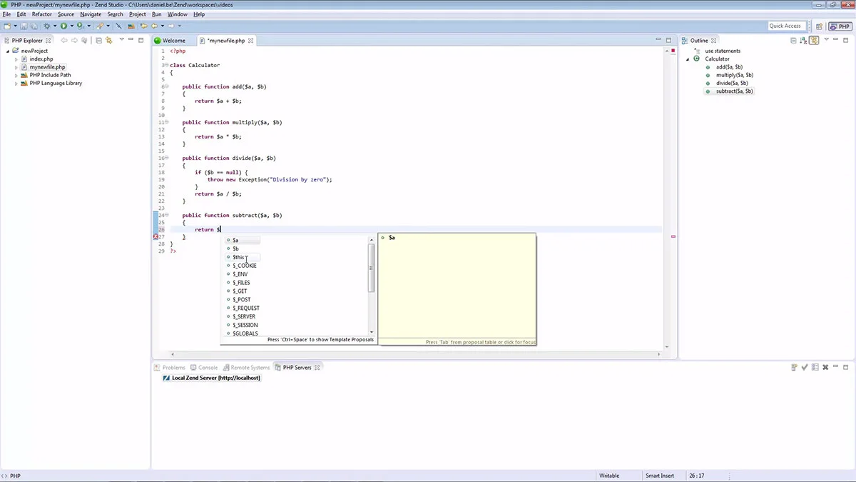
Zend Studio Interface

Slide 18



Any Question ?

Slide 19
THANK YOU
BIJAY KOIRALA

